Slide 1

Synthetic Data Generation for Document Text Recognition
Dr. Ashlin Deepa R N
GOKARAJU RANGARAJU INSTITUTE OF ENGINEERING AND TECHNOLOGY
Department of Computer Science and Engineering
MINI Project Review
  B Jhansi Lakshmi 20241A0566
  B Srija 20241A0564
  Maria Jabeen 20241A0593
  K Kushi Reddy 20241A0583
23-05-2023

Slide 2
ABSTRACT :
Document text recognition is a technology that recognises text in scanned documents.It is used to convert scanned handwritten text into an accessible electronic version of text.In document text recognition of Indian languages, due to vast size of dataset, explicit preprocessing takes lot of time. To reduce the cost and time of preprocessing, synthetic data generation is introduced which does not require explicit preprocessing.Synthetic data is artificial data that mimics real-world observations and is used to train machine learning models when actual data is difficult or expensive to get. In this project we employ a data preprocessing technique that involves generating synthetic data files from the existing dataset of Indian languages.These files serve as a structured format for managing and organizing the data specifically for document text recognition tasks. This synthetic data is used for training and testing the language models. We use the fastText model as a pre-trained language model, which creates word embeddings and acts as a supervisor for predicting using the synthetic data.
GOKARAJU RANGARAJU INSTITUTE OF ENGINEERING AND TECHNOLOGY
Department of Computer Science and Engineering
MINI Project Review
23-05-2023

Slide 3
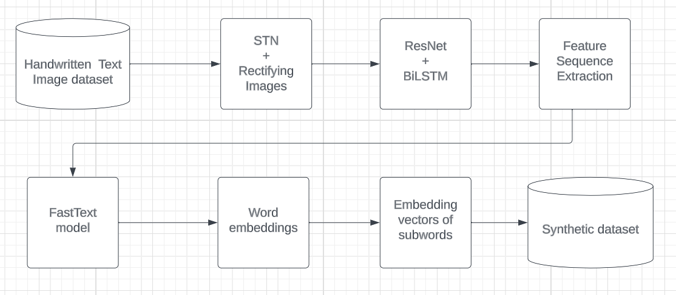
Architecture of the proposed Synthetic database generator:

Slide 4
Algorithm Used in the project
Rectification Module:
The Rectification module rectifies the given input text image.
Using Spatial Transformation Network(STN), rectification is done in order to simplify text recognition.
Encoder Module:
Image from rectified module is forwarded to the encoder module(ResNet based CNN followed by 2-layer Bidirectional LSTM (BiLSTM)).
Encoder module gives a feature sequence as the output.
Semantic Module:
The semantic module uses feature sequence for accurately predicting characters.
Word embedding from pre-trained language model (FastText) acts as a supervisor to predict semantic information.
Embedding vectors of all subwords combined to represent corresponding word.
23-05-2023

Slide 5
Project Implementation & Execution (100%):
In this project, we use word embedding based on skip-gram from FastText, a pre-trained language model.
A word wi is represented by a embedding vector vi .
The embedded representation vi of a word wi inputs to a simple feed-forward neural network.
The input embedding vector vi is simultaneously optimized through the feed- forward network training.
Finally, the optimized embedding vector of a word is very close to the words with similar semantics.
FastText embeds subwords and uses them to generate the final embedding of the word wi.
Embedding vectors of all subwords are combined to represent the corresponding word.
GOKARAJU RANGARAJU INSTITUTE OF ENGINEERING AND TECHNOLOGY
Department of Computer Science and Engineering
MINI Project Review
23-05-2023

Slide 6
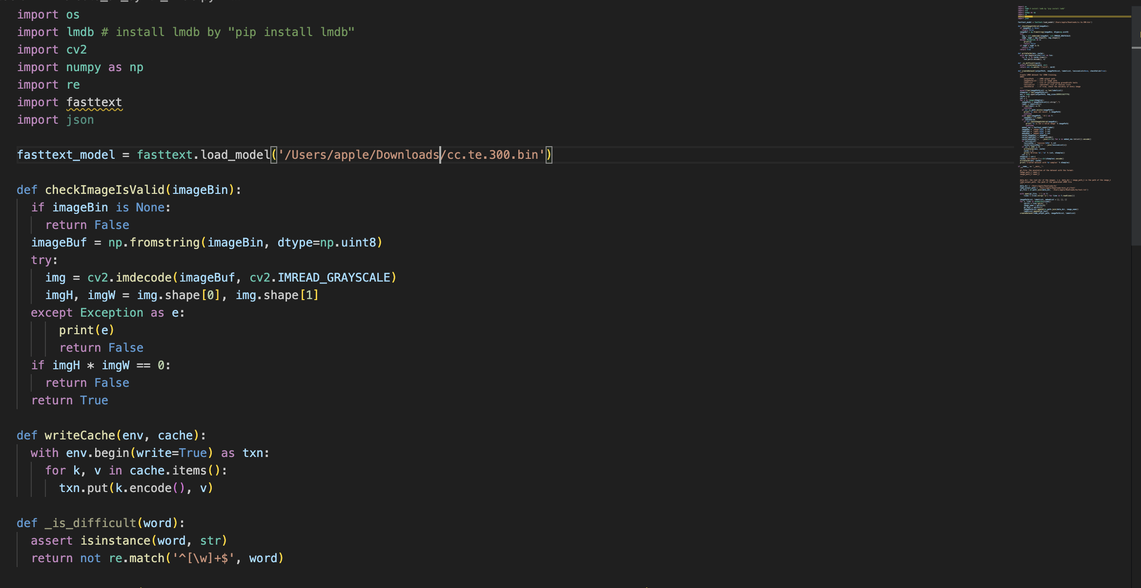
Fig 2.Giving the fast text model as input

Slide 7
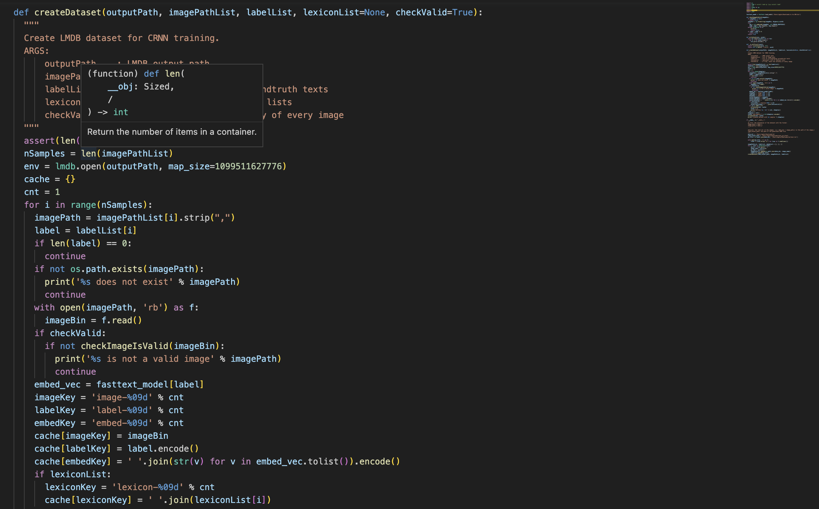
Fig 3. Generating synthetic data

Slide 8
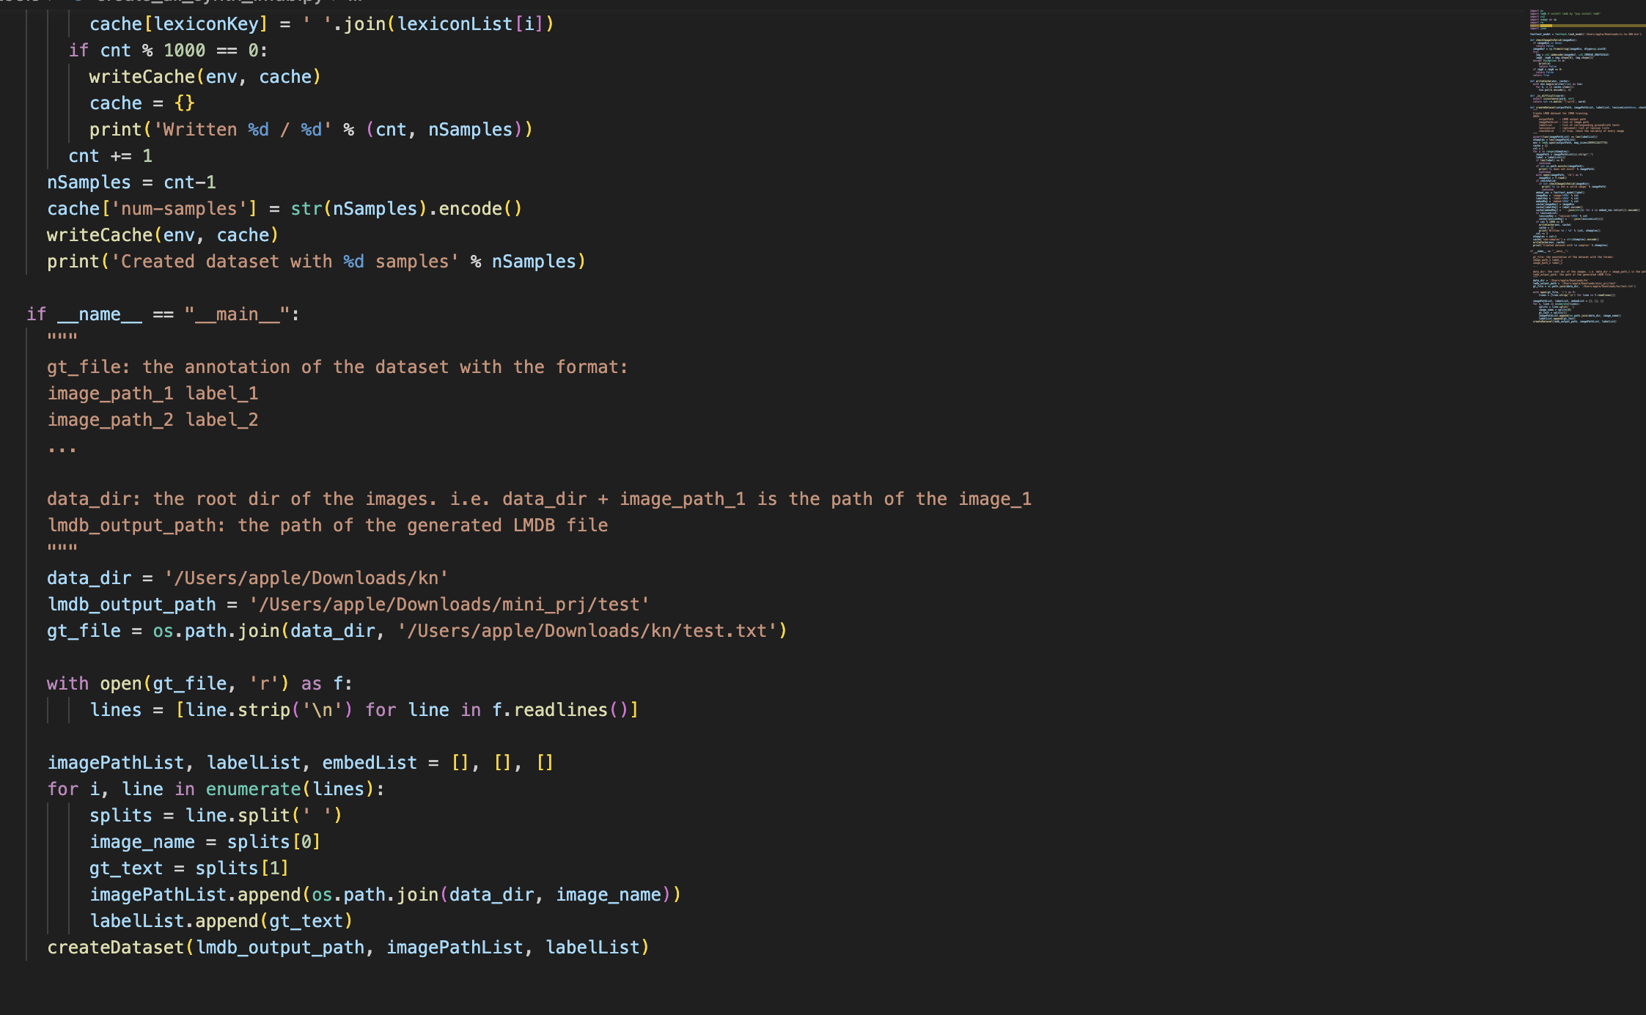
Fig 4. Giving the datasets as input

Slide 9
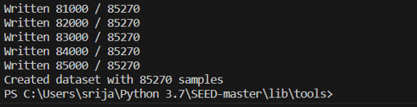
Output:

Slide 10
Results
  Using the fasttext we are able to successfully create synthetic data for Kannada , Tamil datasets. The datasets are divided into training ,testing and validation . The Synthetic data generated are found to be in the mdb format(Microsoft Access desktop database management system ).For each language the mdb files are created for training ,testing and validation datasets.
23-05-2023

Slide 11
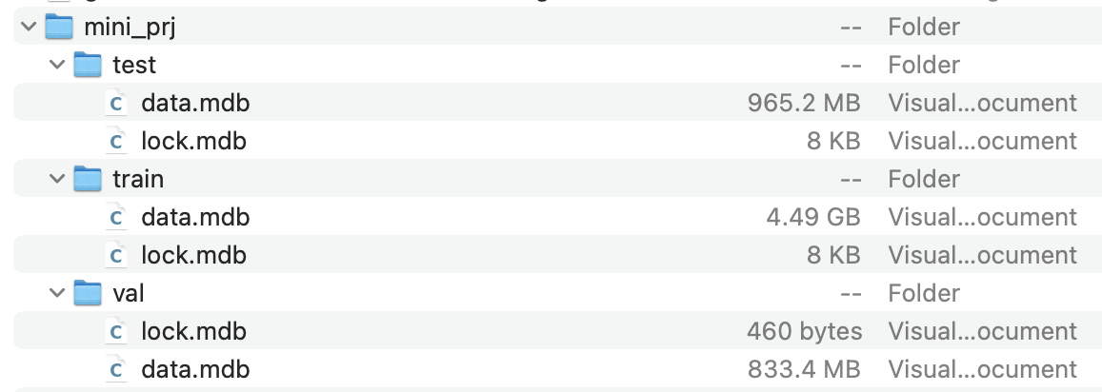
Generated Synthetic files
Fig.5

Slide 12
Conclusion & Further Scope
Thus , the synthetic data can be generated for any language by using pre-trained language model, FastText. We have synthesized the original dataset to make it fit for training and testing. During the decoding phase, the predicted global semantic information(synthetic data) can be used to initialize the decoder to recognize the text accurately during decoding for word images having incomplete and blurred characters. The semantic information will provide an effective global feature to the decoder, robust to the interference in the images .
23-05-2023

Slide 13
Thank You
GOKARAJU RANGARAJU INSTITUTE OF ENGINEERING AND TECHNOLOGY
Department of Computer Science and Engineering
MINI Project Review
23-05-2023

